Slide 1

Bayesian Statistics Workshop
Group 6
Anuj Patekar
Balram Iyengar
Courtney Borstel
Vijayasree Choudary
Notes:
Introducing the Teammates and group number
One line about – Bayesian Prior

Slide 2
Agenda
Introduction
Executive Summary
US holiday Retail Sales Forecast – Dec-2023
US civilian unemployment rate Forecast – Dec-2024
US covid positivity rates Forecast for Dec-2024 against Nov-2023
Conclusion
Q & A

Slide 3
Introduction
What will US holiday season retail sales be for 2023 relative to the 2022 holiday season?
What will the US civilian unemployment rate (U3 rate) be by the end of 2024?
Will US covid positivity rates be higher or lower by December 31, 2024 compared to today (reference date: November 14, 2023)?

Slide 4
Executive Summary
Retail Sales –
Based on factors such as GDP,GDP Per Capita, Inflation Rate, Post Pandemic Trend & Consumer confidence, we forecast that it is almost certain that sales will increase by 4-6% compared to 2022
Unemployment Rate –
Based on factors such as Economic growth- measured by indicators like GDP (Gross Domestic Product),GDP per Capita & COVID’s Impact we conclude that it is probable that unemployment will range from 3.5-6% in 2024.
Covid Positivity Rates ---
Based on factors such as Decline in positive cases, measuring how long other similar pandemics have lasted and what is the % Population Vaccinated out of the total population, We conclude that it is about an even chance that COVID positivity rates will increase or decrease to 5-12% in December 2024 from 10% in November 2023

Slide 5
Year | Holiday Sales (Billions) | Growth vs Previous Year
2004 | 467 | 6.9%
2005 | 496 | 6.2%
2006 | 512 | 3.2%
2007 | 526 | 2.7%
2008 | 501 | -4.8%
2009 | 502 | 0.2%
2010 | 528 | 5.2%
2011 | 553 | 4.7%
2012 | 567 | 2.5%
2013 | 583 | 2.8%
2014 | 611 | 4.8%
2015 | 628 | 2.8%
2016 | 646 | 2.9%
2017 | 678 | 5.0%
2018 | 690 | 1.8%
2019 | 716 | 3.8%
2020 | 782 | 9.2%
2021 | 881 | 12.7%
2022 | 929 | 5.4%
What will US holiday season retail sales be for 2023 relative to the 2022 holiday season?
Average : 4.1 %
Source : National Retail Federation

Slide 6
Current Context
We know that the 2022 US retail holiday sales were $929 billion,
With our Bayesian prior being a 4.1% increase in sales,
We predict that the 2023 US holiday season retail sales will increase by about $38 billion,
Resulting in our forecast for the 2023 US holiday season retail sales to be at approximately $967 billion.

Slide 7
US Holiday Season Retail Sales Projections 2023
Bayesian Question Clustering
How is the economic health of the country?
GDP
GDP Per Capita
Inflation Rate
Post Pandemic Trend
Consumer confidence
How has COVID changed consumer shopping behavior?
Changes in Consumer confidence?

Slide 8
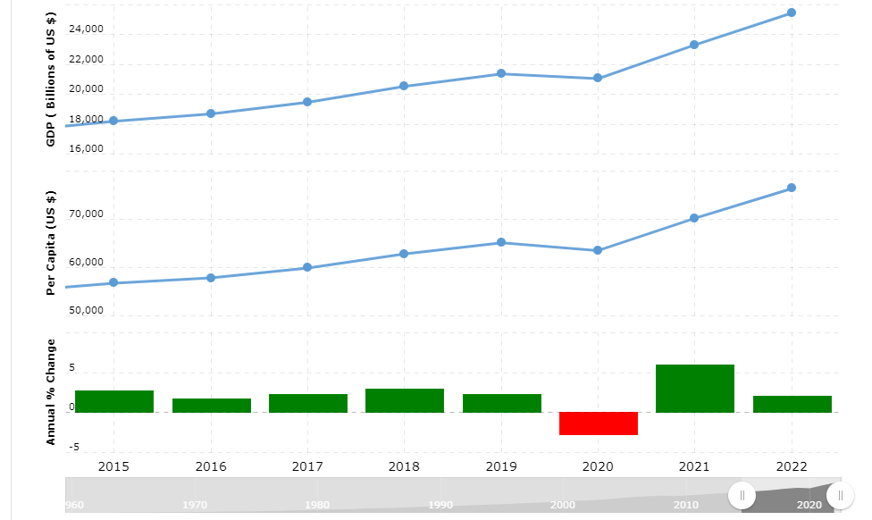
US Retail Projections By 2023
GDP Growth
US economy has shown strong recovery, to restore positive GDP growth even after COVID-19’s impact in 2020 We believe, the increasing GDP would positively help consumers and contribute to the holiday sales. Therefore, we expect the GDP to grow positively in 2023 are therefore keeping our prior to 4.1%
For Source: World Bank

Slide 9
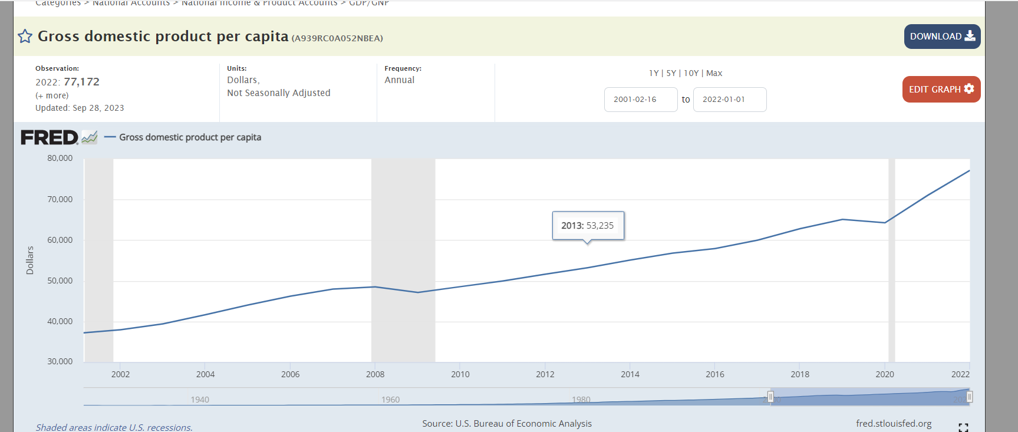
US Retail Projections By 2023
GDP Per Capita
A consistent increase is observed in GDP per Capita which signals strong economic output per person and providing insight into the standard of living of the Population. Given the consistent growth in GDP per Capita, we believe consumers will have strong buying power and therefore we are keeping our prior unchanged to 4.1 %
Source: US Bureau of Economic Analysis - Page1 Page2
Notes:
The increasing Per Capita GDP signifies a higher standard of living, reflecting greater economic output per person. This suggests improved access to goods and services, elevated income levels, and potentially an enhanced quality of life. Consequently, individuals are likely to continue making purchases to afford an improved lifestyle. Therefore, our Bayesian prior remains at 4.1%.

Slide 10
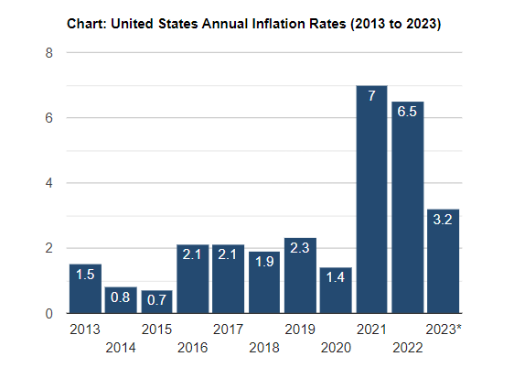
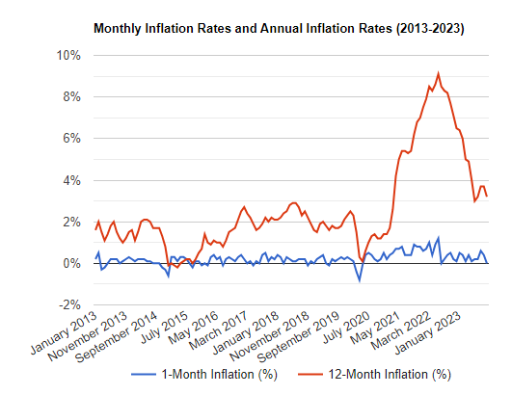
Inflation Rate
Per the graph, it shows that inflation rate has spiked in 2021 and it has been recovering, currently it is 3.2% (Oct-23).
Considering that inflation has remained higher than in previous years since 2012, with average of 1.56%, we believe it could have an impact on consumer purchasing behavior.
Financial institutions (banks) are expected to increase interest rates to curb inflation, affecting individual finances and leading to reduced savings.
Therefore, we believe it would impact consumer wallets and we are reducing the Bayesian prior by 0.10% to 4%
Source: U.S. Bureau of Labor Statistics

Slide 11
US Retail Projections By 2023
Post Pandemic Sales Trend
We calculated post-COVID average growth for holiday sales (i.e. 2020, 2021, 2022) & it is significantly higher than all previous years before COVID (7.9%). This growth is mainly driven by factors such as increased online purchases, the emergence of new businesses, and people taking advantage of online offers. Considering these trends, we are adjusting the Bayesian prior upward by a range of about 4-6%.
Source : National Retail Federation

Slide 12
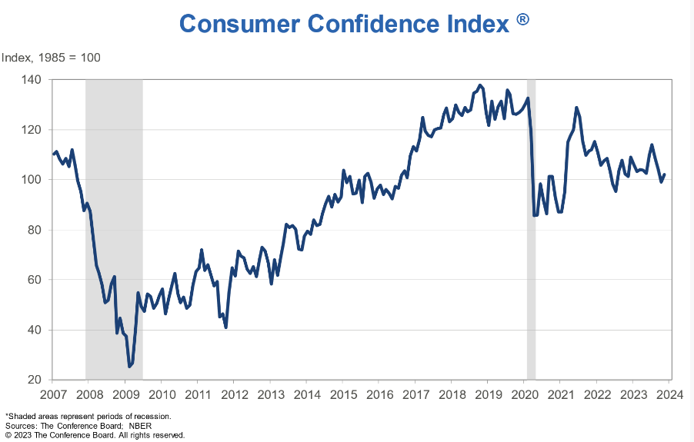
US Retail Projections By 2023
Consumer Confidence
A consumer confidence index is currently in the range of 100-105 which suggests consumers are optimistic about the current and future economic conditions and therefore will be willing to spend & invest during the holiday season.
Given, the positive index we are keeping our prior unchanged.
For Source: The Conference Board

Slide 13
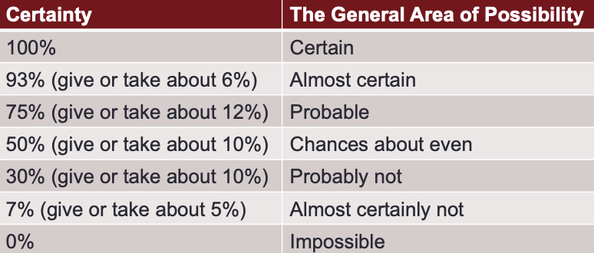
US Retail Projections By 2023
Forecasting Probability :
Considering Bayesian context research and our hypothesis, we establish a 93% confidence level for a 4-6% increase in holiday sales compared to the previous year in 2022.
From the Sherman Kent chart, we conclude that it is almost certain that sales will increase by 4-6% compared to 2022.
Notes:
Confirm this slide in terms of what is certainty

Slide 14
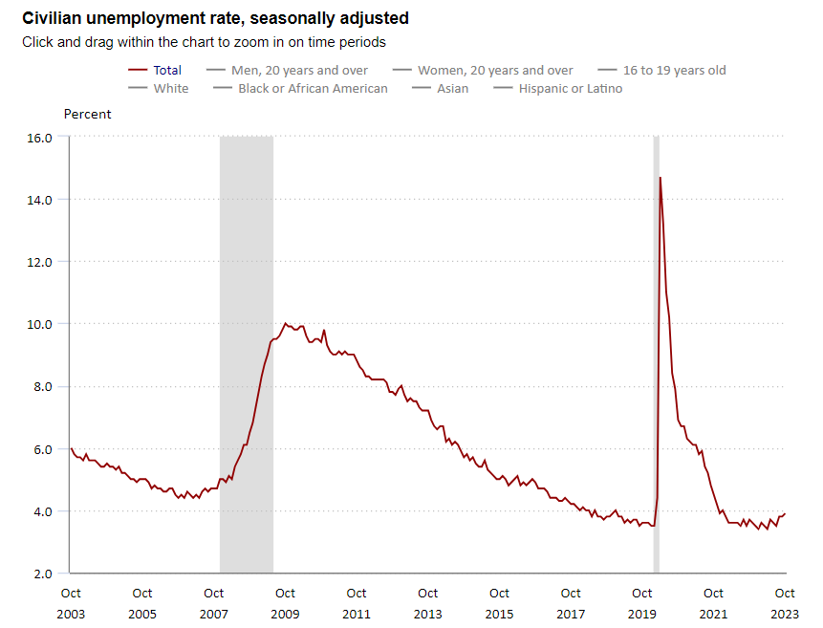
What will the US civilian unemployment rate (U3 rate) be by the end of 2024?
Setting up Bayesian Prior
Based on last 20 years data, the average unemployment rate in USA is 5.4%. Therefore, we are setting Bayesian Prior forecast as 5.4%.
Source : U.S. BUREAU OF LABOR STATISTICS

Slide 15
Current Context
We know that the 2022 Civilian unemployment rate is most recently reported as 3.9% as of October 2023,
With our Bayesian prior being a 5.4% average Civilian unemployment for the past 20 years,
We predict that the 2024 unemployment rate will range between about 3.5-6%.

Slide 16
2023 Unemployment Rate Projection
Bayesian Question Clustering
Economic growth- measured by indicators like GDP (Gross Domestic Product),GDP per Capita?
Global events impact?

Slide 17
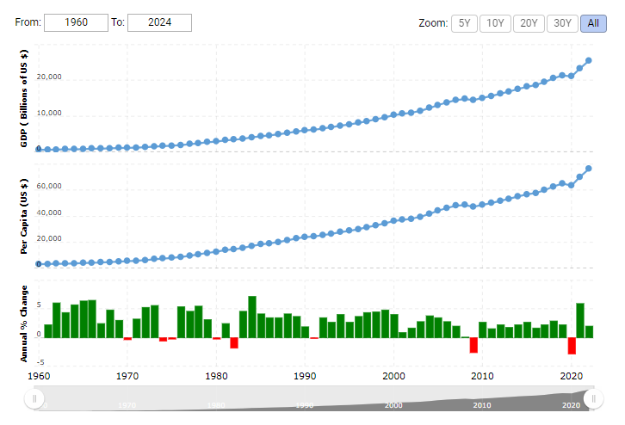
2023 Unemployment Rate Projection
GDP Growth & Per Capita Income
Given a strong recovery in the economy after COVID, rise in Per Capita Income & reduction in inflation rate we believe business would have right environment to thrive and therefore help reducing the unemployment.
However, there are no major shifts in economic policies foreseen and therefore we are keeping our Bayesian Prior for unemployment unchanged.
For Source: World Bank

Slide 18
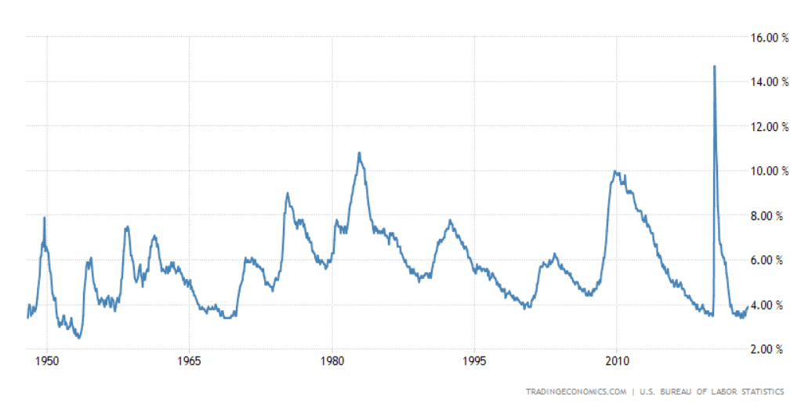
2023 Unemployment Rate Projection
Impact of major global events
COVID had impacted most industries barring a few exceptions (ex. Technology). Also, global events such as wars (Ukraine & Russia) might have an impact on US economy. Historically SARS (2002-2003), H1N1 Influenza Pandemic (2009-2010) have had a short term impact on business employment. However, we could not find evidence and data to prove correlation between them. The Housing Bubble crash may have impacted unemployment in 2008-2009.
In the current scenario, no major impact is observed because of COVID and therefore we are keeping our forecast prior unchanged to 5.4%.
With that being said, there are clearly outliers in the past 20 years of unemployment, with COVID-19 and the Housing Bubble crash of 2008. This indicates that our Bayesian prior may be skewed, and our forecast may be slightly off.
Unemployment Rate
Source : U.S. BUREAU OF LABOR STATISTICS

Slide 19
2023 Unemployment Rate Projection
Forecasting Probability :
Considering Bayesian and our question clusters, we establish a 75% confidence level for a 3.5-6% average in civilian unemployment in 2024, due to average unemployment levels being skewed by outliers due to Covid and the Housing Crisis.
From the Sherman Kent chart, we conclude that it is probable that unemployment in 2024 will be around the same as last year (i.e. at 3.9%), and range from 3.5-6%.

Slide 20
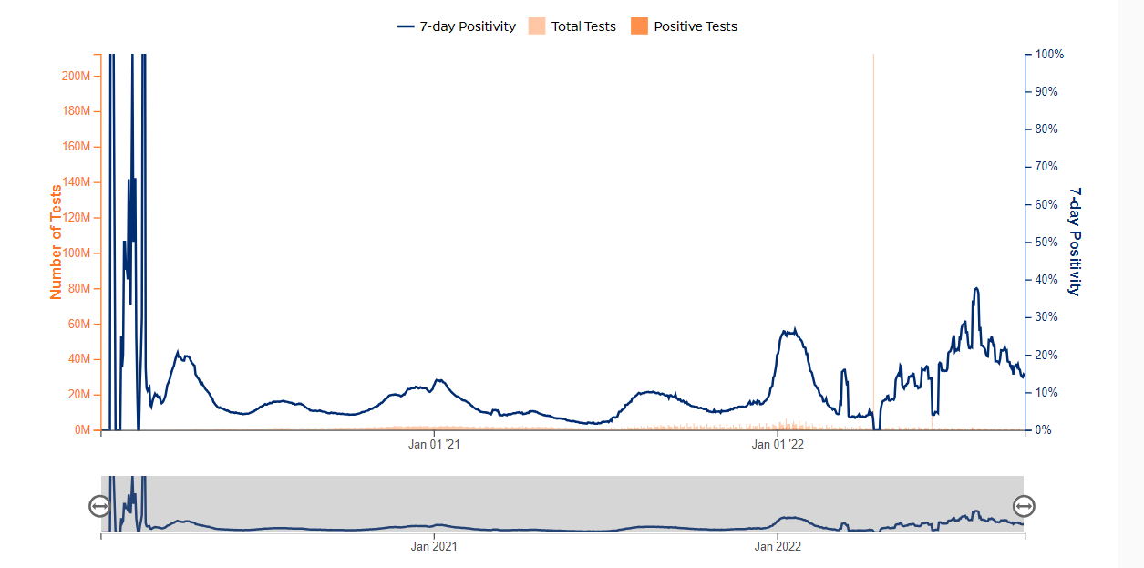
Will US Covid positivity rates be higher or lower by December 31, 2024 compared to today (reference date: November 14, 2023)?
COVID Positivity rate
Year | Hospitalized COVID-19 Patients | Test Volume | Test Positivity Rate %
2020 | 1073885.44 | 24694634 | 8.77%
2021 | 2763242.44 | 26246755 | 6.51%
2022 | 2007753.41 | 16644378 | 10.51%
2023 | 683028.6 | 4221990 | 8.15%
Bayesian Prior (Average) : 8.1 %
More than 30 states across the US have stopped reporting testing positivity or significantly scaled down their testing reports from Sept 2022. Therefore, we are calculating the Bayesian Prior based on the limited data available since Sept’22.
For Source: Center for Disease Control and Prevention

Slide 21
Current Context
We know that Covid positivity rates for November 14, 2023 were about 10%,
We also know that positivity rates are declining and are currently averaging at 8.1%,
Meaning that we predict that Covid positivity rates will decrease by December 2024.

Slide 22
Bayesian Covid Positivity rates Forecast
Bayesian Question Clustering
Decline in positive cases?
In what month to COVID-19 cases rise the most?
How long have other pandemics lasted?

Slide 23
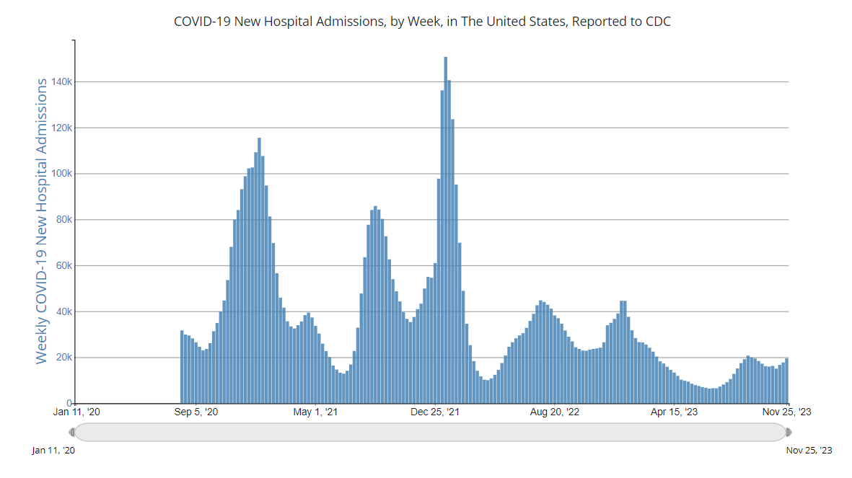
Covid Positivity rates Forecast
COVID Cases have been on a steady decline and even with the risk of new variants, the number of positive cases haven’t increased.
However, reporting of positive cases has gone down, making these reports have variable results, per the CDC.
Therefore, we are changing our positivity forecast (Bayesian prior) to range between about 6-10%.
Source : Center for Disease Control and Prevention

Slide 24
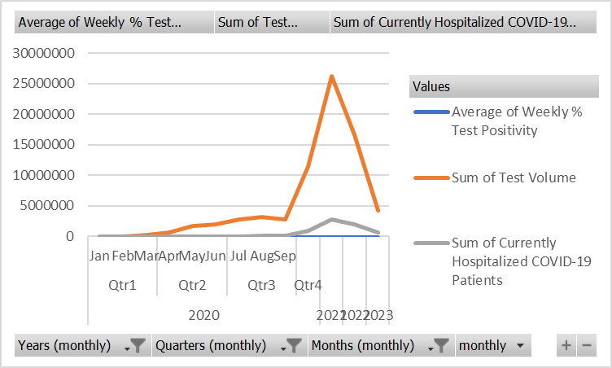
Monthly Positivity Rates
As shown, Covid cases have been likely to rise in the winter months of each year.
Therefore, it is probable that Covid cases may rise again by next December.
With this information, we will increase the range of our forecast to indicate this context, where the positivity rates may rise or fall from 10% to about 6- 12%.
Source : Center for Disease Control and Prevention

Slide 25
Past Pandemic Data
Most pandemics historically have only lasted for 2 years after which the positivity has fallen drastically owing to factors such as vaccination, public health measures and herd immunity.
For ex.
Spanish Flu (1918-1919) Asian Flu (1957-1958) H1N1 Influenza pandemic (2009-2010). Therefore, we are reducing our estimates further to say that the range may change from 5-12%
Source : Center for Disease Control and Prevention

Slide 26
Bayesian Covid Analysis
Forecasting Probability :
Considering the Bayesian prior, we establish a 50% confidence level for this research and conclude that December 2024 may have an average of 5-12% positive cases which is a possible increase or decrease as compared to November 14, 2023, at 10%.
From the Sherman Kent chart, we conclude that it is even chance that COVID positivity rate would increase or decrease to 5-12% in December 2024 against November 2023.

Slide 27
Conclusion
What will US holiday season retail sales be for 2023 relative to the 2022 holiday season?
Bayesian Prior : 4.1%
Post Bayesian Question Constraints and Review : 4-6%
What will the US civilian unemployment rate (U3 rate) be by the end of 2024?
Bayesian Prior : 5.4%
Post Bayesian Question Constraints and Review : 3.5-6%
Will US covid positivity rates be higher or lower by December 31, 2024 compared to today (reference date: November 14, 2023)?
Bayesian Prior : 8.1%
Post Bayesian Question Constraints and Review : 5-12%

Slide 28
Questions?

